Slide 1
Extreme nonlocality with a single photon
Vlatko Vedral
Oxford and Singapore
vlatko.vedral@qubit.org

Slide 2
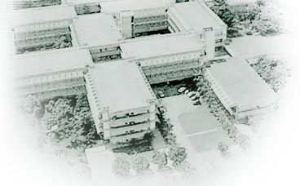


In collaboration with…
Libby Heaney
Marcelo Franca Santos
Adan Cabello
L. Heaney, A. Cabello, M. F. Santos, V. Vedral
Extreme nonlocality with one photon,
arXiv:0911.0770.

Slide 3
Overview
Background:
  GHZ-state all-versus-nothing test of nonlocality
Extreme nonlocality with one photon:
  W-state test of nonlocality
    Equivalence with the GHZ test
  Implementation
  Outlook

Slide 4
Single photon nonlocality

Slide 5
Single photon nonlocality
Hessmo, Usachev, Heydari, and Bjork,
Experimental demonstration of single photon nonlocality.
Phys. Rev. Lett. 92 180401 (2004).
Dunningham and Vedral,
Nonlocality of a single particle.
Phys. Rev. Lett. 99 180404 (2007).
Tan, Walls and Collett,
Nonlocality of a single photon.
Phys. Rev. Lett. 66 252 (1991).
Hardy,
  Nonlocality of a single photon revisited.
  Phys. Rev. Lett. 73 2279 (1994).
Greenberger, Horne, and Zeilinger,
Nonlocality of a single photon?
Phys. Rev. Lett. 75 2064 (1995).

Slide 6
GHZ all-versus-nothing test of local realism

Slide 7
All-versus-nothing test of local realism
Bell’s proof and CHSH inequality based upon statistical predictions and inequalities.
Simpler proof can be achieved with perfect correlations and without inequalities.

Slide 8
All-versus-nothing test of local realism
Define elements of local reality that are incompatible with some predictions of quantum mechanics.
EPR’s criterion of elements of reality:
“If, without in any way disturbing a system, we can predict with certainty (i.e. with probability equal to unity) the value of a physical quantity, then there exists an element of physical reality corresponding to this physical quantity”.
Locality: sites are measured individually and at a rate faster then any communication between them.

Slide 9

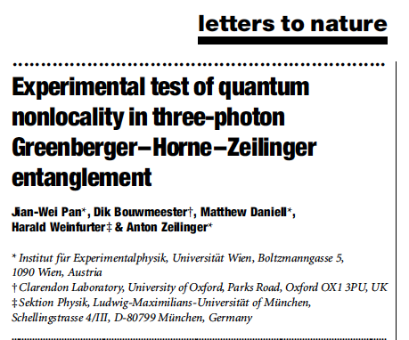
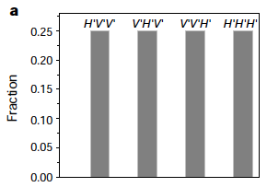
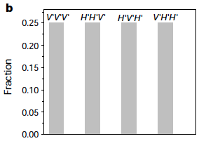
Non-statistical test for a three qubit GHZ state
Elements of reality
Fourth local realist prediction:
This is violated all of the time by outcomes of measurements on the
GHZ state.
Quantum
Classical

Slide 10
Extreme nonlocality with one photon

Slide 11
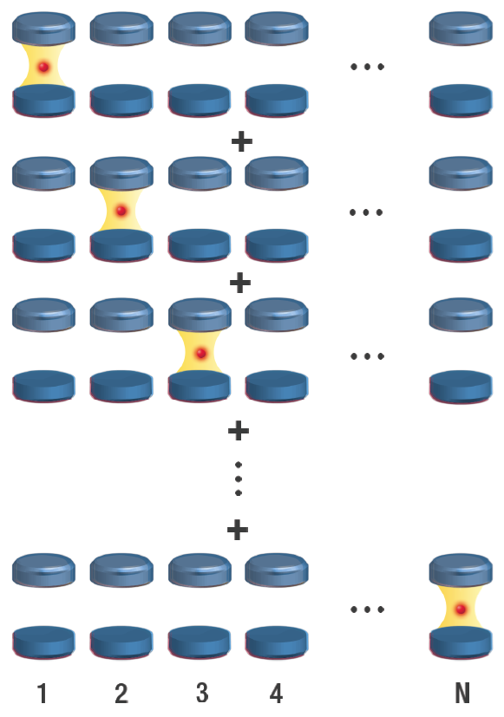


Single photon over N sites
Applies to any general N qubit W-state

Slide 12
Overview of proof
Derive N different sets of elements of local reality that lead to a prediction that is satisfied by local realistic models.
This prediction can be contradicted by measurements on a quantum mechanical systems.
In our example, an element of reality is the presence or absence of a photon in a given site irrespective of what observable we choose to measure.
For three qubits, see A. Cabello, Phys. Rev. A. 65 032108 (2002)

Slide 13

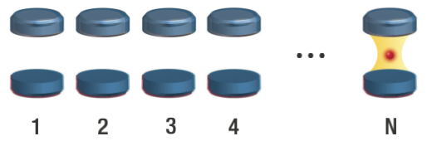
First set of elements of reality
Measure Pauli-Z, i.e. photon number, on each site:
  outcome z_j=+1 means no photon was found on site j,
  outcome z_j=-1 means the photon was found on site j.
If no photon is found in the first N-1 sites, then we can predict with certainty the number of photons in the final site.
Z
Z
Z
Z
Z

Slide 14
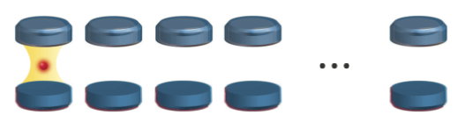

A further N-1 different sets of elements of reality
All similar so describe in detail one set:
Make Z measurements on sites 3-N, if no photon is found, sites 1 and 2 are always correlated in X basis.
X
X
Z
Z
Z
x₁= x₂
z=0
z=0
z=0
x₁=x₂ are elements of reality

Slide 15
A further N-1 different sets of elements of reality
Repeat the same measurements N-2 more times, but with the X measurements on different sites.
After the N-1 different sets of measurements, we have the following elements of reality:
x₁=x₂, x₂=x₃, x₃=x₄, ...
… , x_{N-1}=x_{N,} x_{N}=x_{1.}
X
Z
Z
Z
X
z=0
z=0
z=0

Slide 16
Local realist prediction
Local realism predicts that an X measurement on each of the sites will give the same values
X
X
X
X
X
x₁ = x₂ = x₃ = x₄= ... = x_{N}

Slide 17
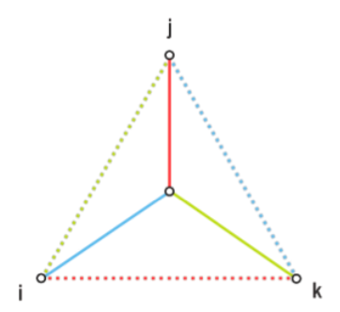
Predictions of local realism for four sites
Dashed lines: no photons found in those two sites, i.e. z_{i}=+1.
Solid line: correlated in the x basis.

Slide 18
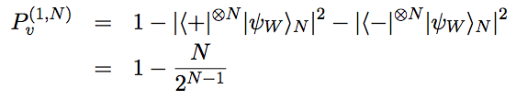
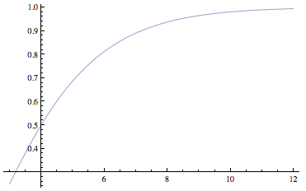

Quantum mechanical prediction
X
X
X
X
X
N=10, P_{v}~1
N=4, P_{v}=1/2
N=3, P_{v}=1/4

Slide 19
Quantum mechanic prediction in the limit of many sites.
The W-state created from a single photon behaves like a GHZ state and shows an always-always-…-always-never contradiction.
Local realism prediction of identical X outcomes for each site is never satisfied.
Surprising such a contradiction arises with a non-stabilizing state, i.e. a state without perfect correlations.

Slide 20

Quantum mechanical prediction on four qubits
Dashed lines: no photons found in those two sites, i.e. z_{i}=+1.
Solid line: correlated in the x basis.
Each colour: different measurement setting.

Slide 21
Ideas for implementation

Slide 22
Implementation
Preparation of the W state.
Need to measure each site in Z and X basis.
X measurements: perform Hadamard gate and measure in z basis.

Slide 23
Preparation
Send photon through a diffraction grating into optical fibres that guides photon to cavity.
Array of coupled microcavities where the photon hops between them.

Slide 24
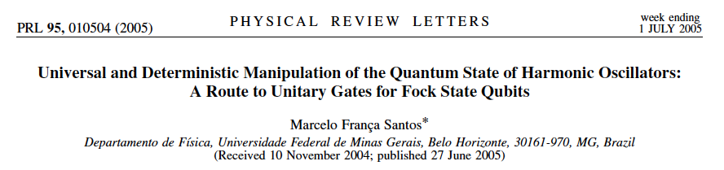
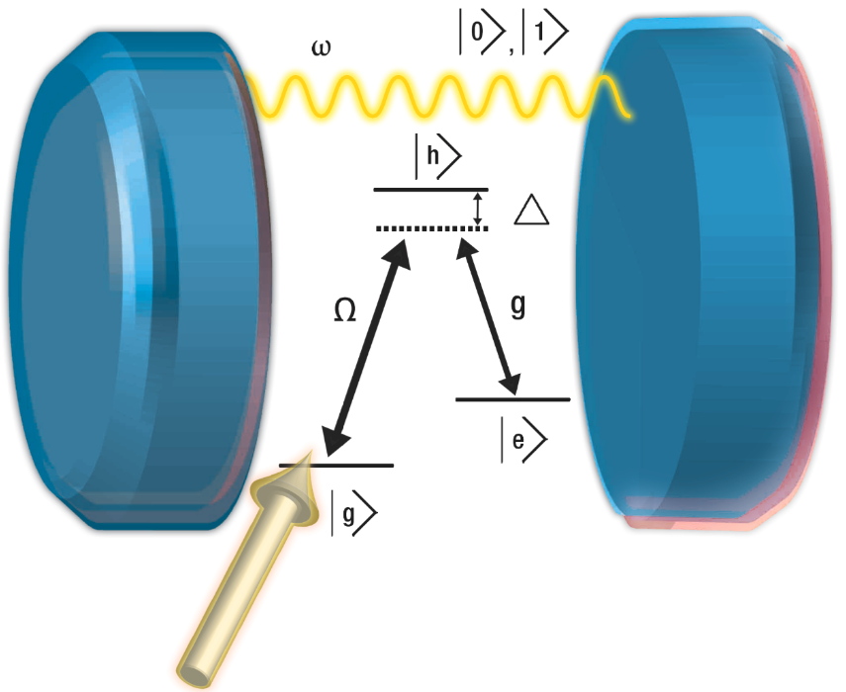

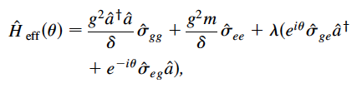

Hadamard gate on the sites

Slide 25

Hadamard gate on the sites
Three steps:
Couple three level atom to the mode for a certain time.
Flip the state of the atom.
Couple three level atom to the mode again so that the final state of the mode as been transformed as

Slide 26
Outlook and conclusions

Slide 27
Conclusions
Fact: A single photon distributed over many distant sites is able to demonstrate an extreme all-versus-nothing violation of local realism in a similar way to the GHZ test of non-locality.
Beauty: Consequence of wave-particle duality.
Truth: Sustains Feynman’s view that superposition is the only true mystery in quantum mechanics.

Slide 28
Outlook
How do errors affect our test?
How do we ensure that we have the W state to begin with?
Can we test using the vibrational modes of ions?
Can we test with massive particles?

